Slide 1
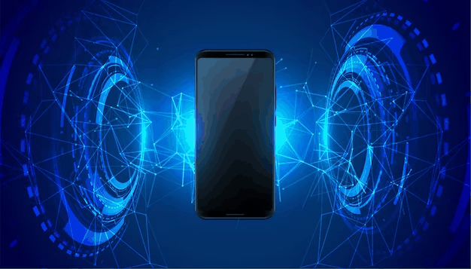
Mobile Technologies
Mr Butler
Advanced Level
Theory
Digital Technology

Slide 2



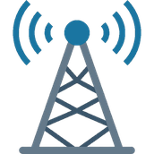


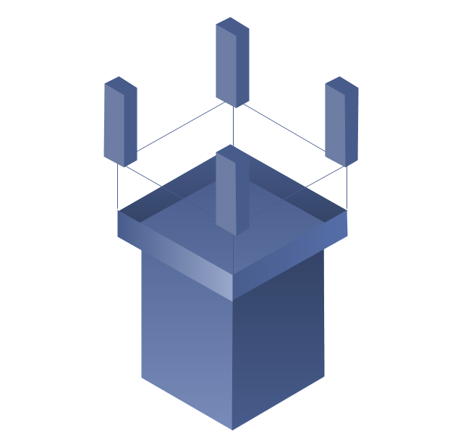


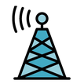

Learning Intentions
Describe how technology supports mobile phone communication:
  mobile phone masts,
  cells,
  handoffs,
  base station controller,
  mobile switching centre and
  public switched telephone network (PSTN) telephone system

Slide 3
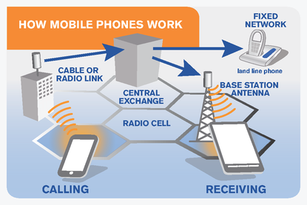
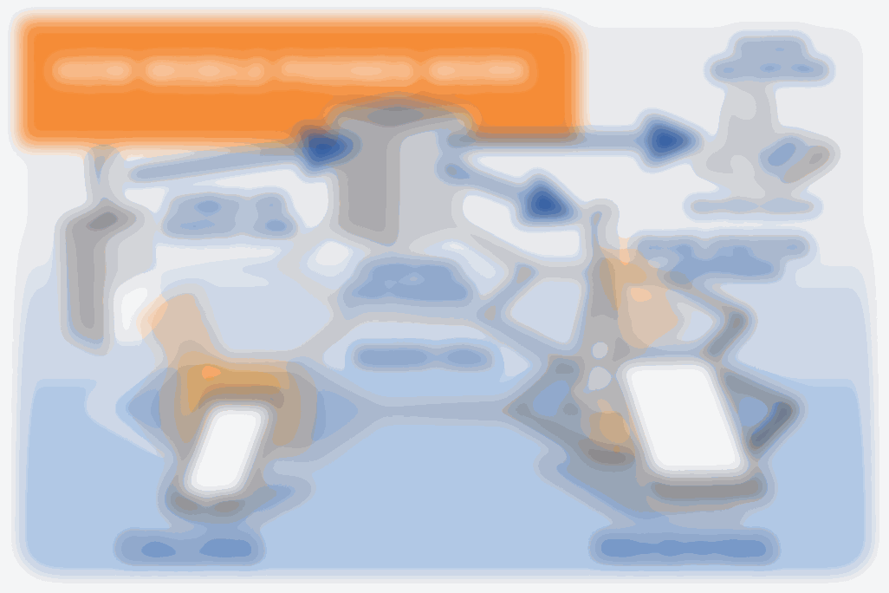
How do Mobile Phones work?
When a mobile phone call is made the microphone within the mobile phone picks up the voice signal and a microchip converts it into a radio wave signal so that it can be transmitted over the mobile network.
The phone's antenna will broadcast this signal to the nearest mobile phone mast.
The mast receives the signal and transmits it to its base station.
The area over which the base station has control is known as a cell and the base station will coordinate the transmission of the signal across the cell.
  Calls made from one mobile to another on the same network will be routed through base stations until they arrive at the destination phone.
  Phone calls made to mobile phones on a different network may take a lengthier route.
The radio transmitter and receiver contained within a mobile phone itself are not capable of transmitting signals over long distances. The numbers are sent to the nearest base station and passed on through neighbouring base stations to the handset of the destination number.

Slide 4
What happens when I switch on a Mobile Phone?
A mobile phone uses low intensity microwave signals in order to transmit and receive voice and data information.
  Essentially they are small radios embedded with mini transmitters.
The mobile phone transmits radio signals when switched on enabling it to broadcast its radio location so that calls can be diverted to it. Mobile phones communicate using a network of cells to transmit data.
When a phone is powered up it listens for a System Identification Code (SID) on the control panel. This is a unique code assigned to each carrier/network provider.
  If the phone cannot find any control channels to listen to, it knows that it is out of range and displays a ‘no service message’.
  When the phone receives an SID it compares it to the SID programmed into its hardware. If the two SIDs match, the phone knows that it has connected to its home network.
  The phone will send a registration request and the Mobile Telephone Switching Office (MTSO) will register the phone and keep track of its geographical location in a database.
    The MTSO is the mobile equivalent of the PSTN
    It routes calls between different regions of the network. Different telecoms companies and network providers – for example EE, Vodafone and O2 in the UK – are interconnected to form a single virtual network that spans an entire country.

Slide 5
Tl;dr
The mobile phone uses a special radio frequency to contact the nearest mobile phone mast
A separate radio frequency is used to transmit the phone conversion
Each phone mast controls a cell
Adjacent cells overlap to ensure maximum coverage
If there is more than one phone mast in range, the mast receiving the strongest signal from the mobile phone is used
As the phone user moves out of the mast’s range, a nearby mast will take control of the call
A local base station controls a number of phone masts
The local base station routes the phone call to its mobile switching centre

Slide 6
mobile phone masts
The area where you live is divided up into smaller areas, each area is served by its own masts and base station.
  These areas are referred to as cells.
The cells are in the shape of a hexagon. Cell masts and base stations are placed strategically to ensure maximum cell coverage. As a user moves across a city, during a call, they will move between cells.
The call must be transferred from one cell to another smoothly. The network automatically switches coverage responsibility from one base station to another. This process is called handoff.

Slide 7
mobile phone masts
The use of cells means that the system can handle many more calls at once, because each cell uses the same set of frequencies as the cells located close to it.
  The more cells, the greater the number of calls that can be made at once.
  So in large built up areas there are more cells than in less populated areas.

Slide 8
mobile phone masts
Mobile phones can also be used to make phone calls to landlines. A Mobile Switching Center (MSC) carries out switching functions, such as call set-up, release, and routing.
It also routes other services such as SMS messages and conference calls as well as interfacing with the public switched telephone network (PSTN).
The MSC allows base stations to connect to it, while it connects to the PSTN.
  This enables all forms of communication, whether between two mobile phones or a mobile and a landline.
Masts are large high-powered antennae which can send radio signals over large distances from base stations.

Slide 9
Cells
Mobile networks are composed of cells, each of which is capable of providing telecommunications services to subscribers roaming within them. Each cell can only serve up to a certain area and number of subscribers.
  Thus, when any of these two limits is reached, a handoff ensues.
The area covered by a mobile phone operator is divided up into smaller areas called cells.
Each cell is hexagonal and is served by its own masts and base station

Slide 10
Cells
For instance, if a subscriber moves out of the coverage area of a particular cell while entering another, a handoff takes place between the two cells.
The cell that served the call prior to the handoff is relieved of its duties, which are then transferred to the second cell.
A handoff may also be triggered when the number of subscribers using a particular cell has already reached the cell’s maximum limit (capacity).

Slide 11
Handoffs
A handoff refers to the process of transferring an active call or data session from one mobile phone in a cellular network to another or from one channel in a cell to another.
A well-implemented handoff is important for delivering uninterrupted service to a caller or data session user.
A mobile phone call must be transferred from one cell to another without interruption.
The network automatically switches handling of the call from one base station to another

Slide 12
Base Station Controller
A base station controller (BSC) is a critical mobile network component that controls one or more base transceiver stations (BTS), also known as base stations or cell sites.
  Key base station controller functions include radio network management (such as radio frequency control), base transceiver stations handover management and call setup.
TL;DR: A Base Station Controller controls one or more base stations/provides an interface between cells Responsible for call set up and handover management.
It works with a mobile switching centre, providing voice pathways for mobile phones and other compatible devices, such as a land line or the Internet.

Slide 13
mobile switching centre
A base station controller works with a mobile switching centre (MSC) component that is external to the base transceiver stations, enabling it to provide full mobile telephony and fulfil capacity requirements.
Base stations must communicate with the mobile switching centre and data must be managed as information overflow, impacting mobile switching centre efficiency.
  A base station controller eliminates mobile switching centre base station activity management requirements, allowing the mobile switching centre to handle critical tasks, such as traffic balancing and database management.

Slide 14
public switched telephone network (PSTN) telephone system
The public switched telephone network (PSTN) refers to the international telephone system that uses copper wires to carry analogue voice data.
It consists of a collection of individual telephones that are hardwired to a public exchange.
The public switched telephone network is a global system that has developed over several decades.
  From the early research of Alexander Graham Bell, telecommunications companies evolved the PSTN architecture that provided for yesterday's landline voice communications.

Slide 15
public switched telephone network (PSTN) telephone system
One important distinction with the public switched telephone network is that it stands in contrast to private exchange networks (telephone networks using a private switchboard to allow extension numbers to be used).
  Private branch exchanges and other technologies allowed companies and other parties to create more individual telephone lines that were not represented in the PSTN and public landline architecture.

Slide 16
public switched telephone network (PSTN) telephone system
Today, as smartphones and mobile devices continue to flourish, wireless telecom networks are taking up market share and PSTN landline technology is diminishing.
  In some places, less industrialised communities have skipped directly to the use of mobile phones and devices.

Slide 17
Questions
Describe the technology which enables a mobile phone user to make phone calls while on the move [6]
Explain each of the following mobile technology terms.
  Mobile Phone mast [2]
  Cell [2]
  Handoff [2]
  Base station controller [2]
Explain how communications technology enables an uninterrupted phone call to be made between two mobile phones. [6]

Slide 18
Describe the technology which enables a mobile phone user to make phone calls while on the move [6]
The mobile phone uses a special radio frequency [1] to contact the nearest mobile phone mast [1]
A separate radio frequency is used to transmit the phone conversion [1]
Each phone mast controls a cell [1]
Adjacent cells overlap to ensure maximum coverage [1]
If there is more than one phone mast in range, the mast receiving the strongest signal from the mobile phone is used [1]
As the phone user moves out of the mast's range, a nearby mast will take control of the call [1]
A local base station controls a number of phone masts [1]
The local base station routes the phone call to its mobile switching centre [1]

Slide 19
Explain each of the following mobile technology terms.
Mobile Phone mast [2] Cell [2]
Handoff [2] Base Station controller [2]
Mobile phone masts
  Large high-powered antennae
  Which can send radio signals over large distances
  from base stations
Cell
  The area covered by a mobile phone operator is divided up into smaller areas called cells
  Each cell is hexagonal
  and is served by its own masts and base station
  Strategically placed to ensure maximum coverage
Handoff
  A mobile phone call must be transferred from one cell to another without interruption
  as a user making a call moves between cells
  The network automatically switches handling of the call from one base station to another
Base Station Controller
  Controls one or more base stations/provides an interface between cells
  Responsible for call set up
  and handover management
  Works with a mobile switching centre
  providing voice pathways for mobile phones
  and other compatible devices, such as a land line or the Internet.

Slide 20
Explain how communications technology enables an uninterrupted phone call to be made between two mobile phones. [6]
The region is divided up into cells each served by a base station and a number of phone masts
A cell is hexagonal in shape to maximise coverage
The caller’s phone sends a signal to the nearest mobile mast
The mast receives the signal and transmits it to its base station
The base station manages transmission of the signal across the cell it controls
Calls are passed on through neighbouring base stations to the destination phone
If the caller is on the move, they may move between cells
The call is transferred from one base station to another in a process called handoff
The base stations connect to a mobile switching centre

